Slide 1


AI Section 1: Congrats you have a job!

Slide 2



Let’s break the ice!
Who’s your favorite music artist or athlete?
“Emperor penguin and icebreaker” by Brocken Inaglory is licensed under CC BY-SA 3.0

Slide 3
Focus Question
Being able to identify and recruit new talent is a billion-dollar industry in sports and entertainment.
The use of artificial intelligence to comb through huge data sets to identify talent based on important parameters you can set can help speed up the process of finding talented artists and players.
How is AI used in analytics to identify new talent?
Think about how athletes and musicians have been traditionally recruited:
Predictions?
Scouting?
Recommendations?

Slide 4
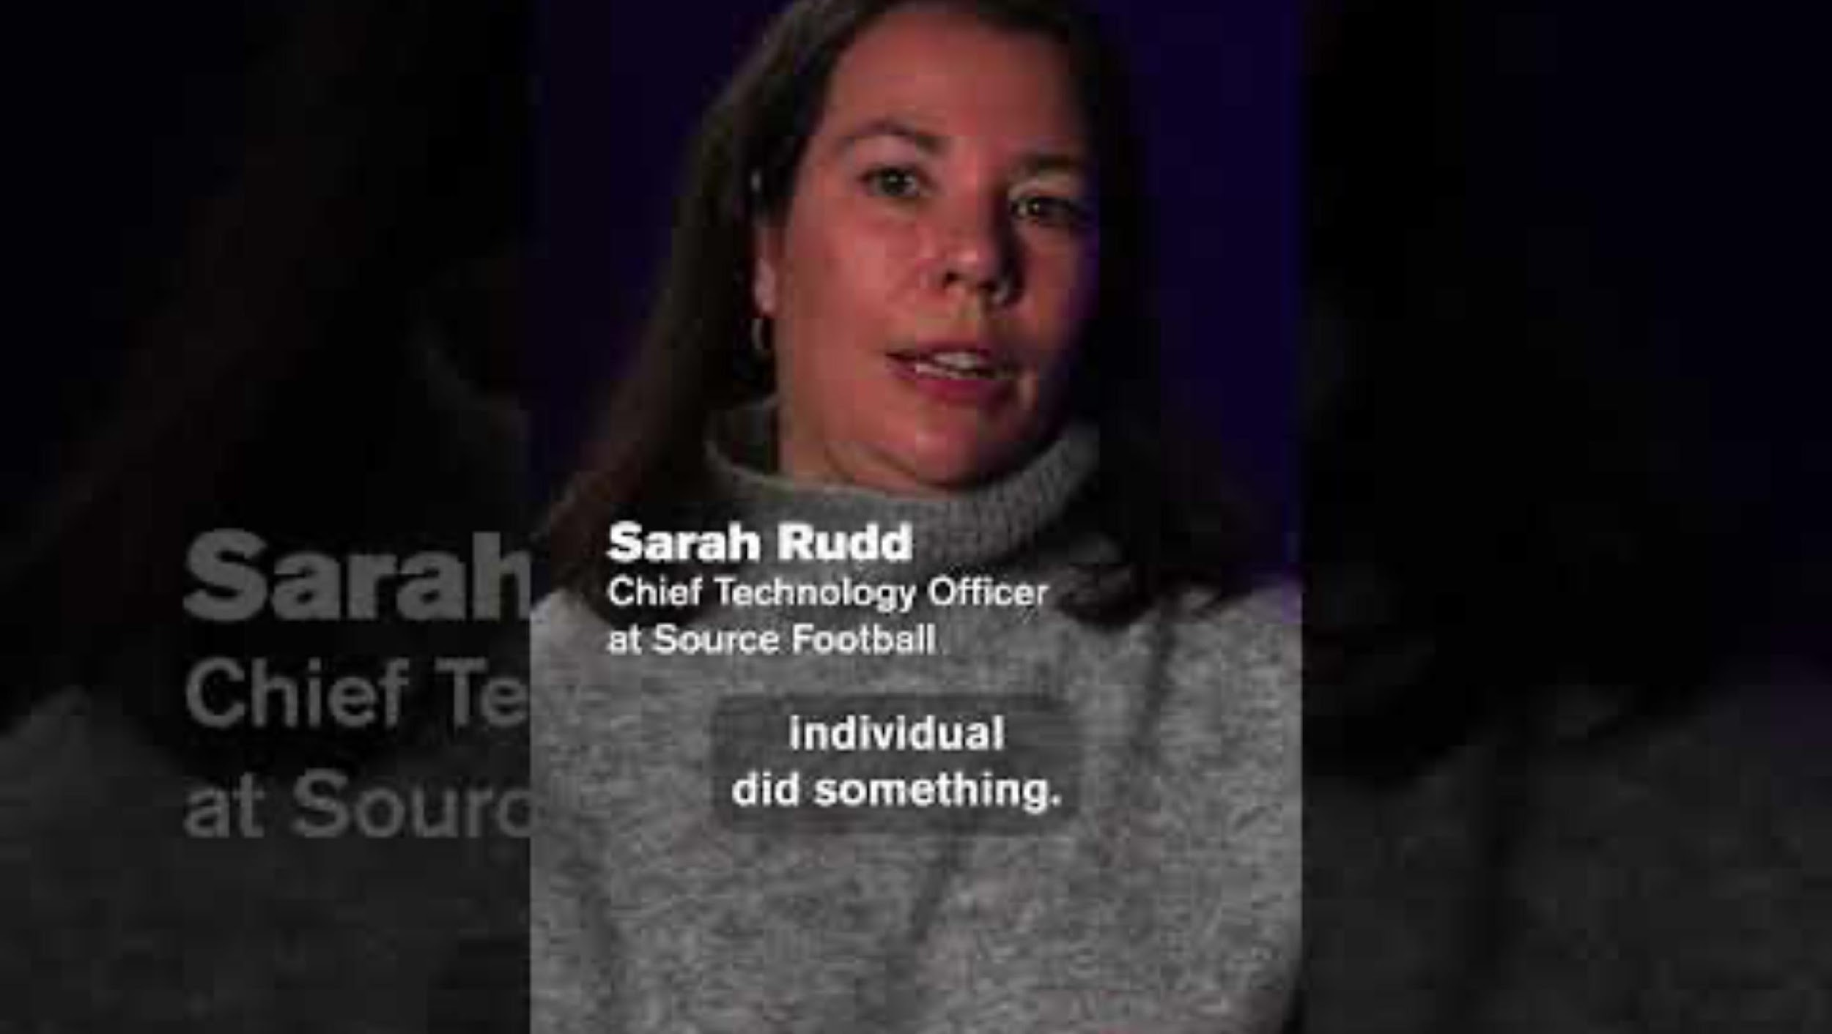

Example of AI Sports
Watch this video on AI in sports
…or this one

Slide 5
AI in Sports and Music
What do you think the value of AI in sports is? What are predictive analytics? How might they be used by teams to recruit great players?
How do you think AI could be used to analyze data for musicians and to identify possible new talent?

Slide 6
Understand Types of Jobs in Entertainment and Sports that Use Data
What does it take to get a position for data analytics in the sports or music industry?
Congrats! You are out looking for a job in the sports or music industry to follow your passion. You have a bachelor's degree from a university in Florida, in some STEM area. You have taken multiple courses in data analytics as that has interested you.
Let’s look at two job postings from LinkedIn!

Slide 7
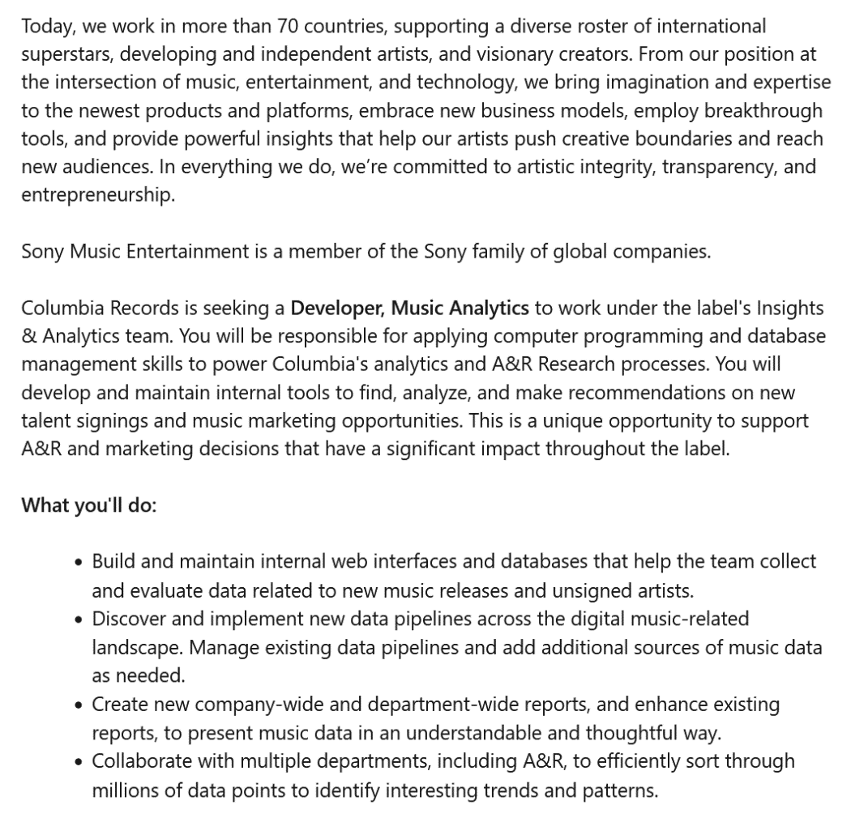
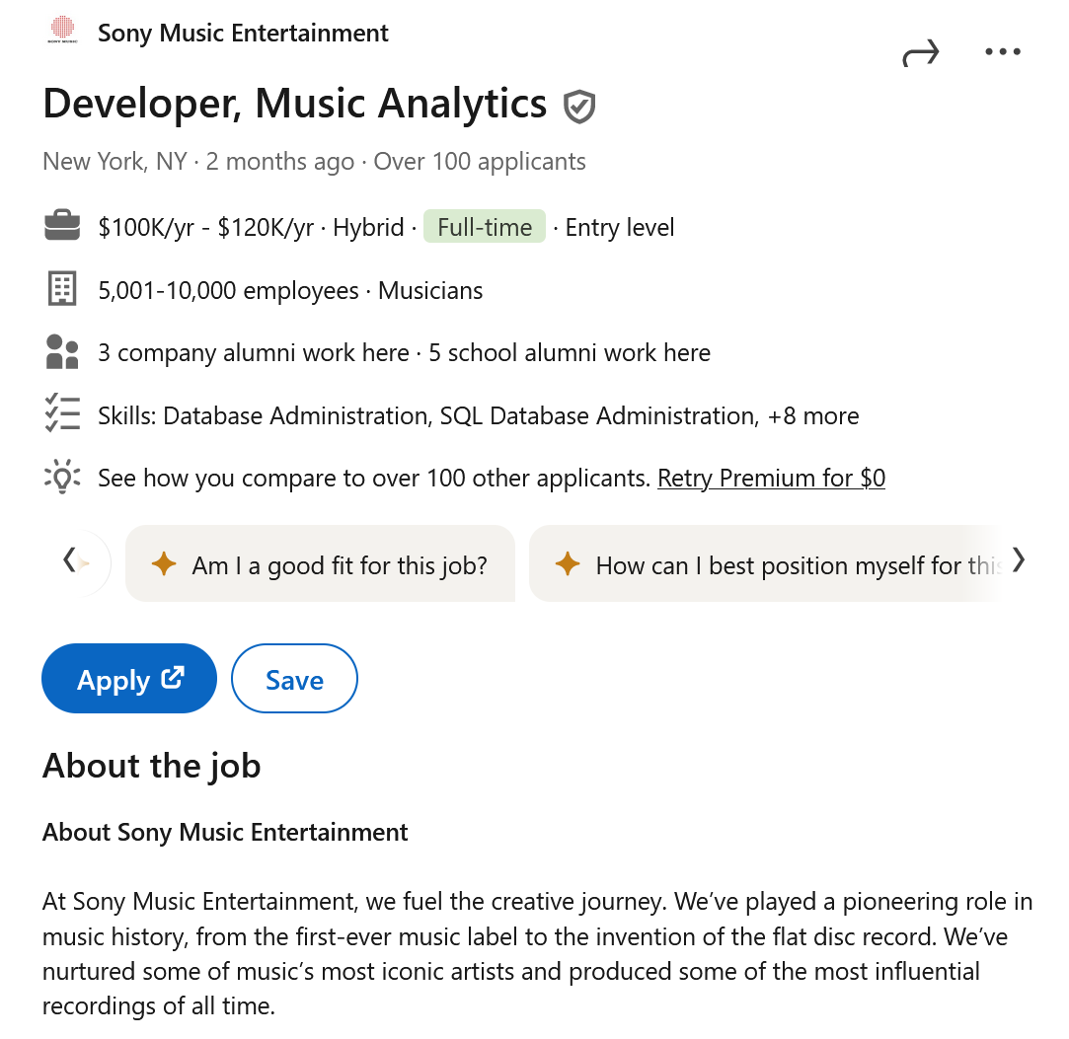
Job 1: Music Industry

Slide 8
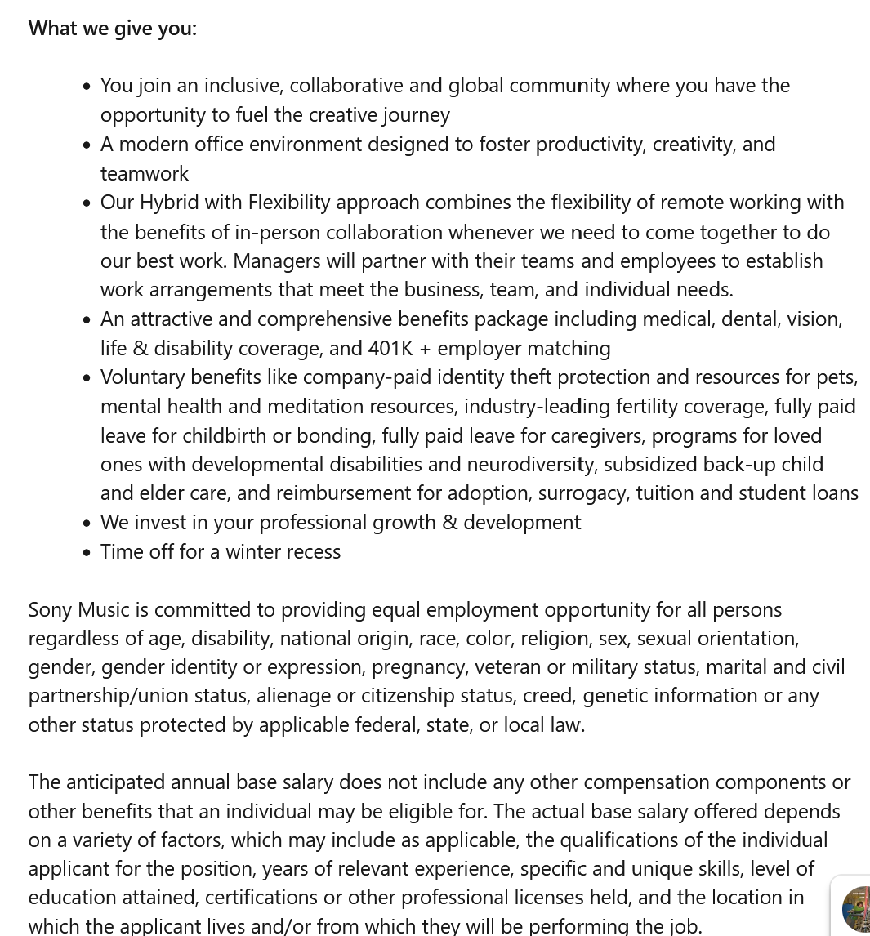
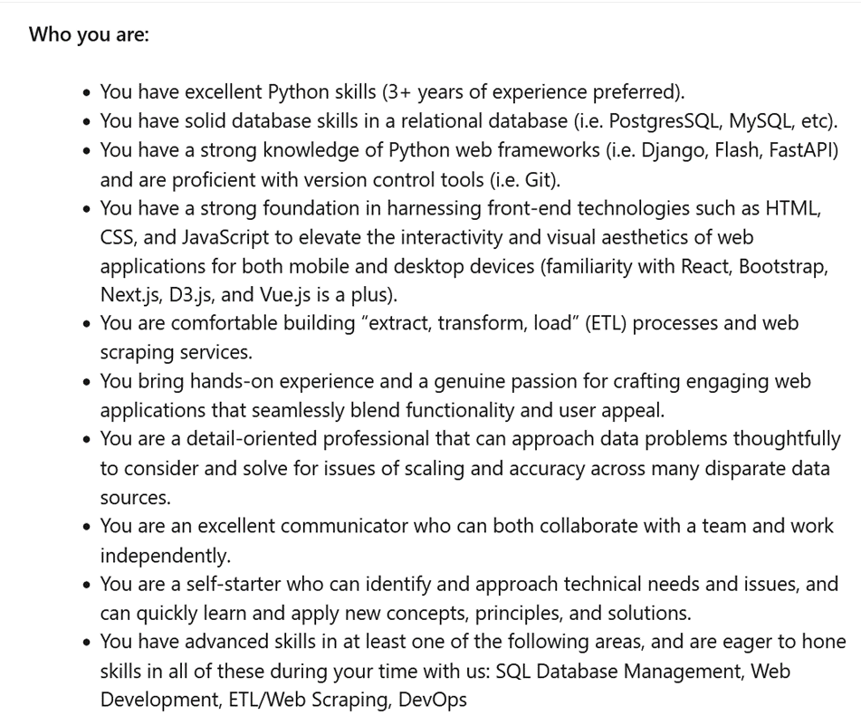
Job 1: Music Industry

Slide 9
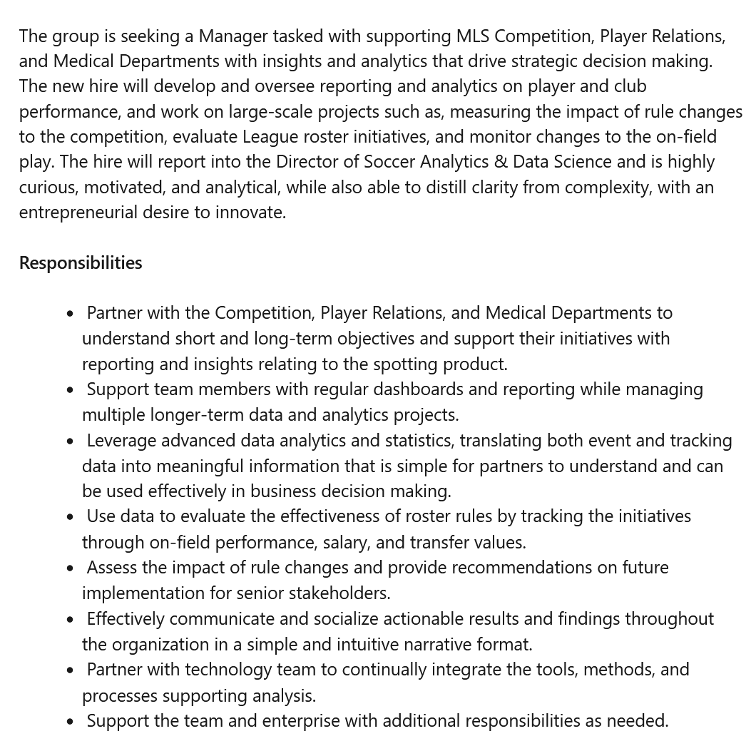
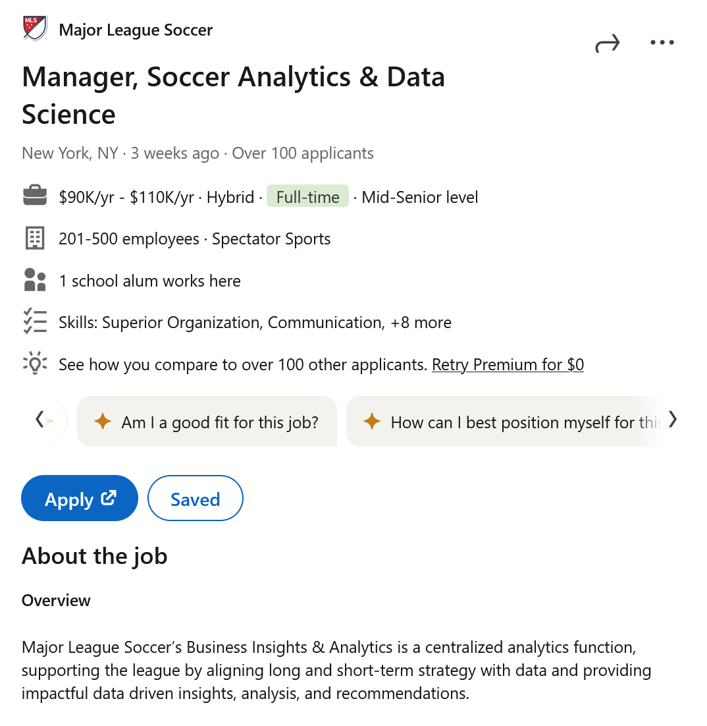
Job 2: Sports Industry

Slide 10
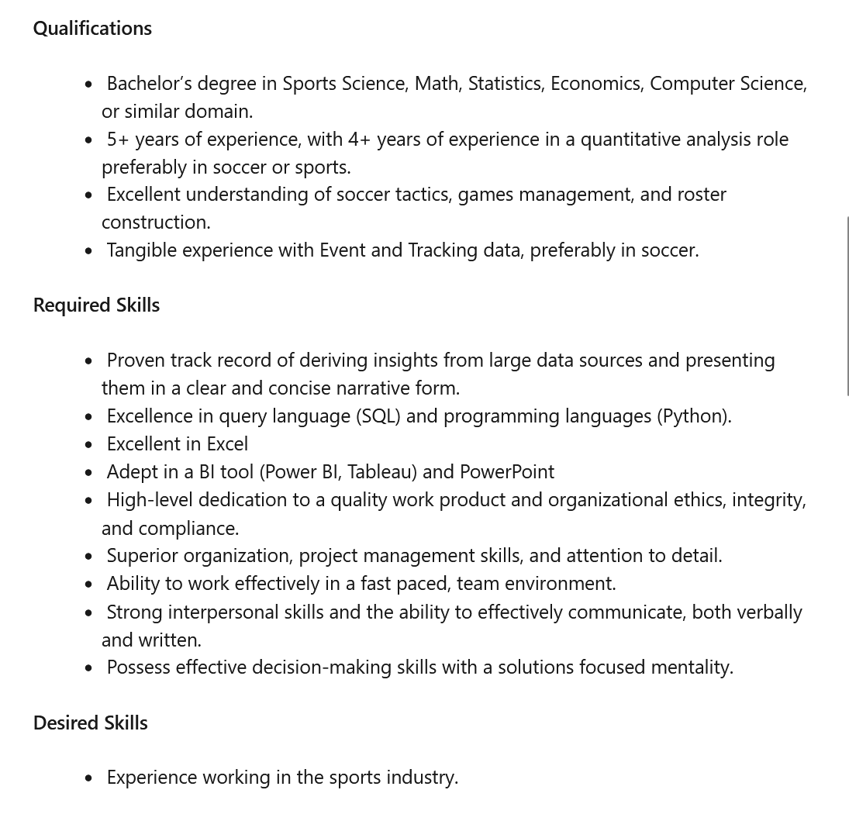
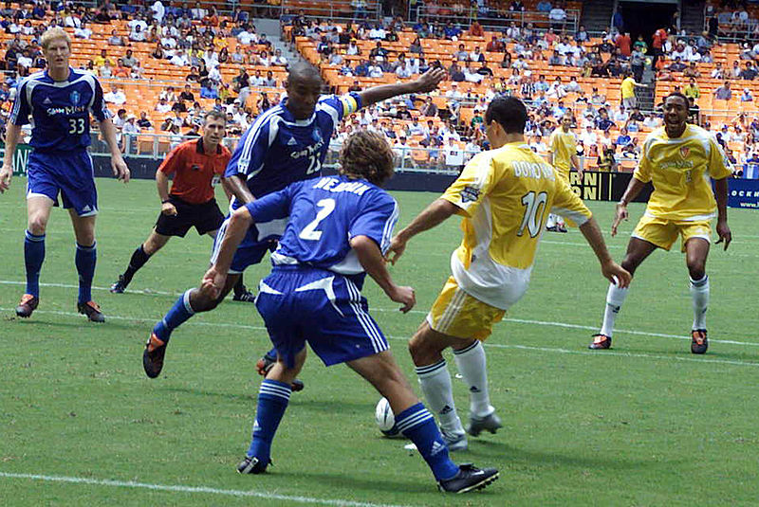
Job 2: Sports Industry

Slide 11
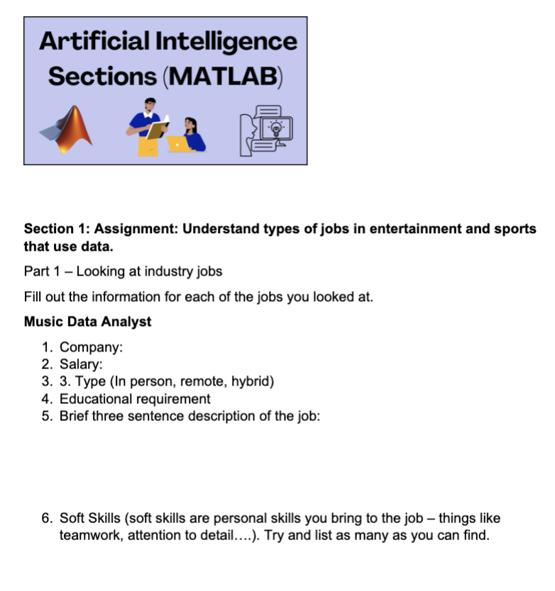
To Do:
Fill out the first part of the worksheet for the job postings.
Go back to the worksheet and fill out the second part where you assess your skills related to the job postings.
Share your skills with a partner and the class. Collectively what skills do you all have, what skills do you all need to develop?
Refine/Reflect
When ever we look at job postings, we should view them as an opportunity to assess our skills and see what new things we can learn. The highest paying jobs require some level of technical skills and we want to think about how we can develop these skills early in our career and school settings.

Slide 12

Understanding the Role of Data in A & R / Sports Analytics
Why is data so important to companies to identify new talent?
Watch this video from Spotify that tells Artists about what data they can collect and use to understand who is listening to their music.

Slide 13

“Data is the new oil”
Read this excerpt from this article which was written for Forbes Magazine. The article is titled "Data as The New Oil Is Not Enough: Four Principles For Avoiding Data Fires" by Nisha Talagala, Mar 2, 2022.
Data is the new oil. Like oil, data is valuable, but if unrefined it cannot really be used. It has to be changed into gas, plastic, chemicals, etc. to create a valuable entity that drives profitable activity. so, must data be broken down, analyzed for it to have value.
“USDA NRCS Texas” licensed under CC BY 2.0

Slide 14
“Data is the new oil”
Data is the new oil because data can be used to derive insights. Depending on what a company does, insights can drive customer retention, upselling, new revenue models, advertising, etc. If data is the new oil, insights are the new money
Due to advances in computing, internet of things, machine generated data and more, data volumes are now exploding. So, we are awash in oil. How do we prevent oil fires, or data related fires - to be more precise, and get good insights?

Slide 15
“Data is the new oil”
Talk with your table partners!
What kind of data did the video tell you would an Artist use to tell how well songs are doing on Spotify?
What other data could you find in Spotify that you know about that could be useful to an Artist to know?
What other websites, apps, or social media platforms would potentially have helpful data for an artist to look at to see how well their music is doing?

Slide 16
API’s
Much of the data housed on sports leagues or entertainment sites is free for use by the public. This makes it really nice to use for analysis.
Up until a few years ago, you had to download all this data as a spreadsheet, like Excel, and work with it in a spreadsheet program.
Now you can API directly into data sets and just pull the data you want? What is an API and how does it work?

Slide 17
What is an API and how does it work?
API stands for “application programming interface.” An API is a set of rules that govern how two machines talk to each other. They let computers talk to other computers to take or share data from them.
When you login to Spotify or Instagram through a computer or cell phone, you are having your device talk to their computer, using several APIs if any data is being shared or collected.
Computer programs that developers use to create apps, can use APIs to call data in from other sources. This is something you will learn to do in MATLAB Programming. APIs are useful as they allow the program to pull data and directly analyze it.

Slide 18
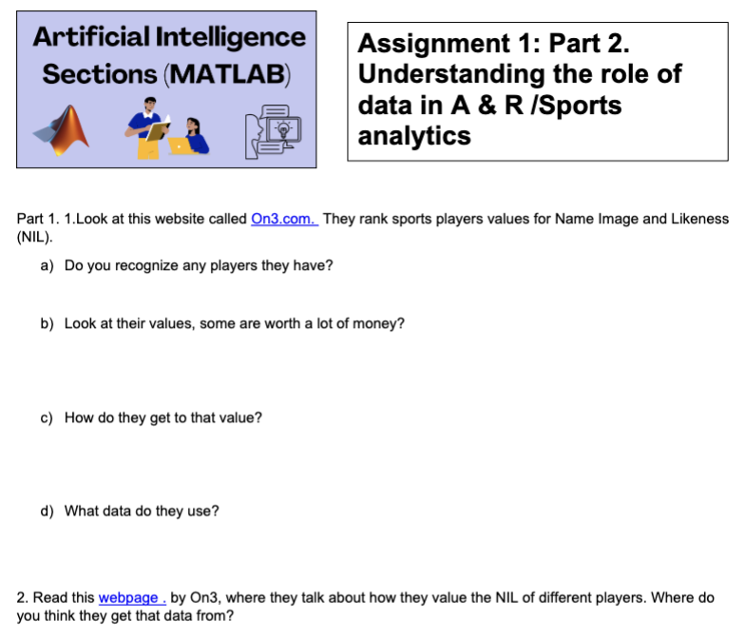
To Do:
Look at this website called On3.com.They rank sports players values for Name Image and Likeness (NIL).
Do you recognize any players they have?
Look at their values, some are worth a lot of money.
How do they get to that value?
What data do they use?
Use this sheet for your answers

Slide 19
To Do:
Read this webpage by On3, where they talk about how they value the NIL of different players. Where do you think they get that data from?
Look at some websites for data (some given, some you find) that can be used to inform for entertainment or sports. What kind of data is found at these sites? How do you download the information? Can the information be accessed through an API?
Share your findings with a partner!
What sites did they come up with different than your sites? Make a class list of possible data sources for the whole class to use later on in the programming section.

Slide 20

Understanding the Role of AI in A & R / Sports Analytics
How are AI and Data used for decision making in Sports Analytics and the Music Industry?
Is it fair to use data to determine how much someone is willing to pay for a sports or concert ticket?
Watch this video on the $1000 dollar concert ticket…
…or watch this one on Sports pricing by the Buffalo Bills

Slide 21
Understanding the Role of AI in A & R / Sports Analytics
Talk with each other and determine the answer to the following questions:
What is Dynamic Ticket Pricing?
What data or parameters go into figuring out the cost of a ticket?
How much of the cost of the tickets for music concerts goes back to Ticketmaster? Is that fair to the artist?

Slide 22
What is Sports Analytics?
Sports analytics is the study of athletic performance and marketing optimization for the success of a sports organization or the player.
There are two main components in sports analytics:
On-field data analytics and Off-field data analytics

Slide 23

On-Field Data Analytics
This area involves tracking key on-field data metrics that could be used to improve in-game strategies, training plans, player recovery from injuries, and in-game usage.
These analytics can also be used to develop nutrition plans, that could improve athletes' performance levels.
It seeks to answer questions relating to on-field performance, such as “which soccer player has scored the most goals in Europe?” or “which player has run the fastest over 20 meters?”

Slide 24
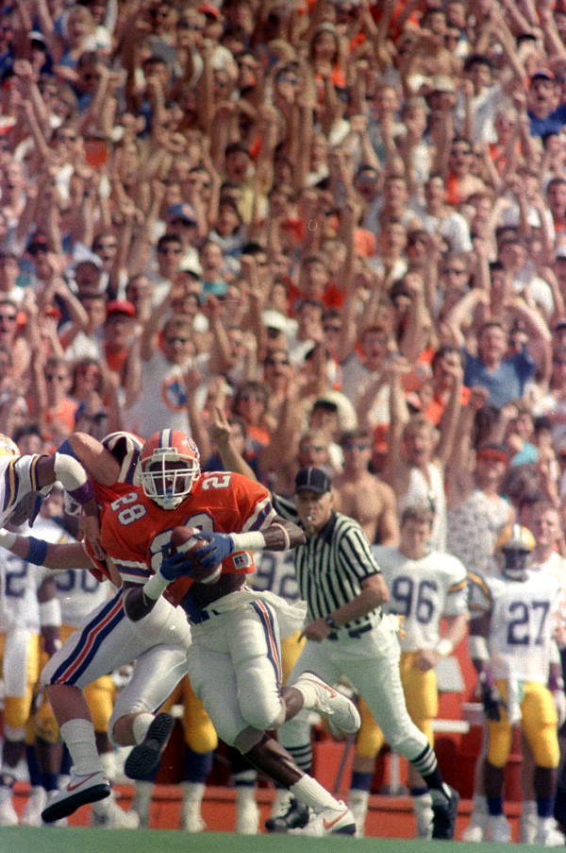
Off-Field Data Analytics
Here, the focus is on the business side of sports. It involves monitoring important off-field data metrics such as ticket sales, merchandise sales, fan engagement, player social media engagement.....
This type of data analytics seeks to assist decision-makers in sporting teams make better decisions directed toward increased growth and profitability of the team.
Players can also track their own social media presence to build their brand and NIL earning potential.

Slide 25

Benefits of Data Analytics in Sports
Informed decision-making
Sports data analytics can be a useful tool for making important strategic decisions.
For example, when Thomas Tuchel, former Chelsea Football Club manager, was asked why he brought on goalkeeper Kepa Arrizabalaga late into extra time, he responded, “So we had some statistics, we were well prepared, that Kepa is the best in percentage in saving penalties.” He added, “There is proof that Kepa is better at this discipline.” Chelsea went on to win the penalty shootout, with Kepa saving two penalties in the process.
Decisions backed by data on and off the field typically lead to more powerful and accurate decision-making.
“Kepa Arrizabalaga” by Catherine Kõrtsmik is licensed under CC BY 2.0
Notes:
More examples highlighting the benefits of data analytics in sports can be seen on the Canvas page

Slide 26
How Different Sports Use Analytics
Although the fundamental purpose of sports data analytics is universal – to gain a competitive advantage through statistics and data analysis – different sports deploy varying methods to collect and analyze data efficiently for their sport.

Slide 27
How Different Sports Use Analytics
Soccer
Sports data analytics forms an integral aspect of off-field decision-making in soccer.
Soccer clubs worldwide have invested heavily in data science and related technology to help boost players' on-field performance and improve off-field decision-making.
This involves tracking and monitoring data such as players' in-game positioning, fatigue during training, distance covered, and other data that may provide greater insight into players' conditioning.

Slide 28
How Different Sports Use Analytics
Baseball
As one of the first sports to embrace sports analytics, Baseball has been setting the benchmark for several years.
Some of the data tracked to aid the MLB team's decision-making are:
The batting average: A statistic calculated by dividing the number of hits by the number of at-bats for that player. This stat reveals a player's tendencies and which pitch tends to strike them out. The purpose is to aid players in identifying what type of pitch is their weakness – it is also the most commonly discussed stat in baseball.
On-base percentage: This is one of the most important offensive stats; It illustrates how often a batter can avoid being put out at the plate and is defined as the percentage of times a player reaches base on a hit, walk, or being hit by a pitch.

Slide 29
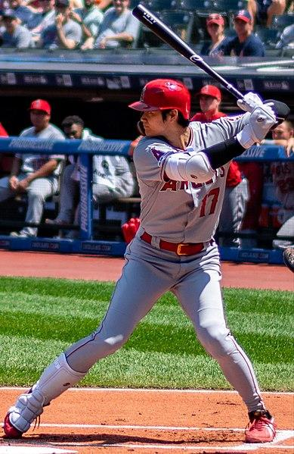
How Different Sports Use Analytics
Baseball
Slugging average: The slugging average measures a player's batting power. It measures the number of bases a player earns on hits. The higher the slugging average, the more likely the player is to hit for extra bases.
You can apply your knowledge of Baseball, Python, and data visualization with Matplotlib and Seaborn in this example New Era of Data Analysis in Baseball project in Data Camp.
“Ohtani batting 2019.08.04” by Erik Drost is licensed under CC BY 2.0

Slide 30

How Different Sports Use Analytics
Basketball
At the most elite level of basketball, teams use data-tracking cameras at all angles of the basketball arena to track every movement made by each player on the court.
This data is then synced with the players' statistics to provide a full breakdown of players' performance.
“Allen Iverson Lipofsky” by Steve Lipofsky is licensed under CC BY-SA 3.0

Slide 31

You talk
Pick a sport with a partner
Think about 3-5 statistics for that sport you think would be important for identifying talent
Share with the class
Start a chart in class or on the board of sports and the important statistics

Slide 32
What Do Sports Analysts Do?
A sports analyst will likely watch their designated sporting event, prepare commentary, and deliver that commentary on air or in print.
Thus, they must have exceptionally strong analytical and communication skills as it accounts for a large proportion of their day-to-day responsibilities.
In addition, sports analysts have a deep knowledge of their chosen sport, which includes a good idea of the historical context and key statistics that define the competition.

Slide 33
How to Become a Sports Analyst
As the growth of the sports industry continues, a natural by-product is a wealth of job opportunities. Individuals with a knack for data analytics and a compelling interest in sports can merge their talent with their hobbies to build a fulfilling career as a sports analyst.
Becoming a sports analyst typically comprises three key components: getting educated, developing skills, and gaining experience.
If you’re wondering how to get into sports analytics, the steps in the following slides can help you.

Slide 34
How to Become a Sports Analyst
Getting Educated
In the long run, education in these two areas will aid you in creating authoritative assessments and predictions based on statistical models.
Many sports analysts will take some form of sports data science degree, whether focused mainly on the sports side or the data science side.
Of course, other types of education can help, whether in sports, statistics, data science, or related fields.

Slide 35

How to Become a Sports Analyst
Developing Skills
Many soft and hard skills are required to become a sports analyst:
Soft Skills:
Having a good relationship with stakeholders certainly goes a long way, as sports analysts are expected to understand the needs of stakeholders (i.e., coaches, directors, etc.) and deliver accurate insights in a timely fashion.
Stakeholders are likely less technical than the sports analyst, meaning insights must be reported in an understandable and useful format to simplify stakeholders' planning and decision-making process.
“Employee Training - Communication Skills Illustration” by Digits.co.uk Images is licensed under CC BY 2.0

Slide 36
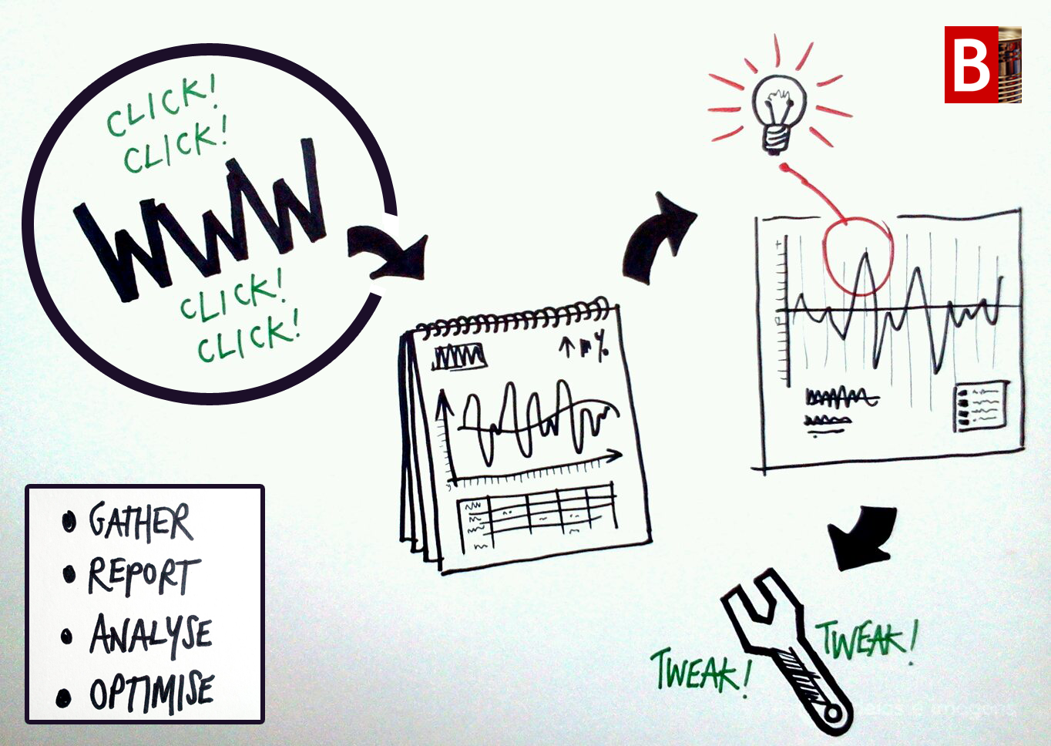
How to Become a Sports Analyst
Developing Skills
Hard Skills:
A key element of a data professional's work is ensuring data is accurate and reliable, which requires good knowledge of how the data is collected, stored, and retrieved. This also includes ensuring data is clean.
Beyond the ability to read, write, communicate, and reason with data, sports analysts must also be equipped with significant technical knowledge of various analytics tools and programming languages
“Web analytics framework” by James Royal-Lawson is licensed under CC BY-SA 2.0

Slide 37
How to Become a Sports Analyst
Gaining Experience
Beginner practitioners often lament the difficulty of breaking into technical fields since hiring managers typically prefer candidates with experience
The saying goes, “but how can I get experience if you only hire people with experience.”
This belief system is based on the idea that a job is the only way to gain experience.
Any task that demonstrates professional experience in data analysis is enough to strengthen the resume of a sports analyst candidate.
Some example tasks include contributing to open-source, working on projects, freelancing, and internships.
Making a portfolio of your projects or having a github site is a good way to share your work with others.

Slide 38
You talk
Think back to the job advertisement you saw
Think about 3-5 skills you have and 3-5 you need to develop
Share with the class
Start a chart in class or on the board for skills you need to develop for sports analytics

Slide 39
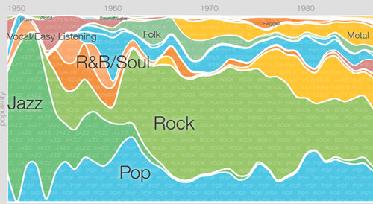
Music A & R Analysis
Before big data, social media and streaming services, people who worked for music companies worked at night, going to multiple clubs and dance halls each night to find new emerging talent.
Social Media and data mining have allowed for a closer relationship can form between super fans, Artists and music labels.
Music providers can now unlock valuable insights into their audience’s listening habits and make adjustments to their business model and social presence based on this data.
Music genre popularity over time

Slide 40
Applications to the Music Industry
AI-Powered A&R Discovery
Music publishing companies and record labels often have their own A&R (Artist & Repertoire) discovery division which is responsible for finding the ‘next big thing’.
But scouting for emerging talent manually can be time-consuming, as it involves sifting through hundreds of different artists and music data (social, broadcast, streaming, touring).
By using predictive analytics and AI, A&R teams can accelerate the talent-scouting process, in turn saving on costs and resources.
Data-driven scouting tools use machine learning to collect data from a variety of sites such as Spotify, social media, or music-specific blogs.
This data can then be used to easily identify new talent, as well as filter out those that aren’t a good match for the label.

Slide 41
Applications to the Music Industry
Data-driven royalty collection
In order to allocate royalties to artists, music consumption has to be tracked. With such a large ecosystem at play (music is spread across multiple streaming sites, blogs, and social media), tracking all this metadata can be a challenge.
This has directly impacted artist compensation, with hundreds of millions in royalties left unaccounted for.
There are apps that allow an artist to add tags and unique labels to all their songs so when they search the internet using an API tool, all copies of the song being used show up. This allows artists to find unauthorized use of their songs.

Slide 42
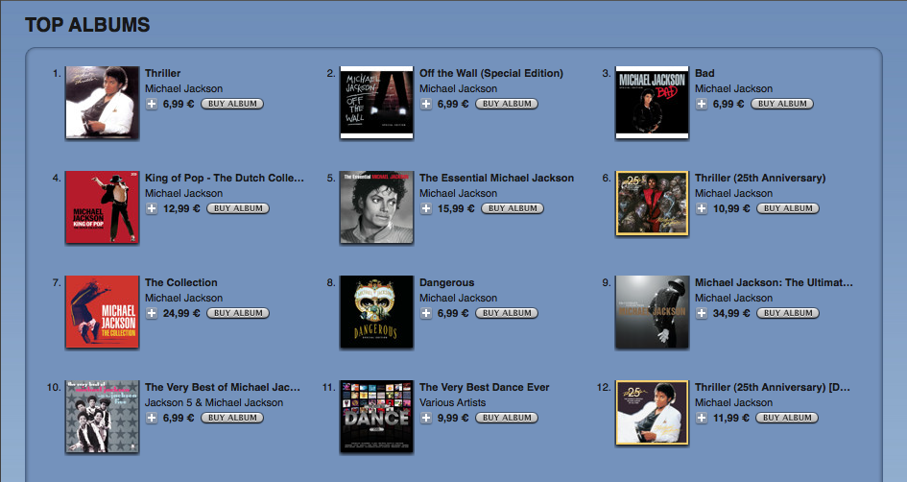
Applications to the Music Industry
3. Predicting the next craze
Finding the next big ‘hit’ – especially amongst listeners – has always been an objective for record labels and music publishing companies.
What will make people tick? What song will be the most popular? What will drive the most downloads/shares/likes?
In 2015, researchers at the University of Antwer were one of the first to create a tool that predicted possible musical hits, which proved reasonably successful.
“Michael Jackson albums on iTunes” by Remco Brink is licensed under CC BY-SA 2.0

Slide 43

Applications to the Music Industry
4. Music Streaming
Music streaming providers such as Spotify use automated data analytics and AI to ask questions based on the huge amounts of data they generate.
This data can then be used to unlock valuable insights into tracks, artists, and listener sentiment, and this information can be sold back to Music companies or to other companies interested in this data.

Slide 44
Wrap Up
Sports analytics involves collecting and analyzing relevant historical statistics that can provide a competitive edge to a team or individual.
With more sporting teams pouring investment into data analytics, several sports and statistics enthusiasts are flocking towards a career as a sports analyst.
Music analytics combines a love of music with large data sets from streaming, social media channels and the internet with statistics and business marketing. This is a career for those who love music and math.

Slide 45
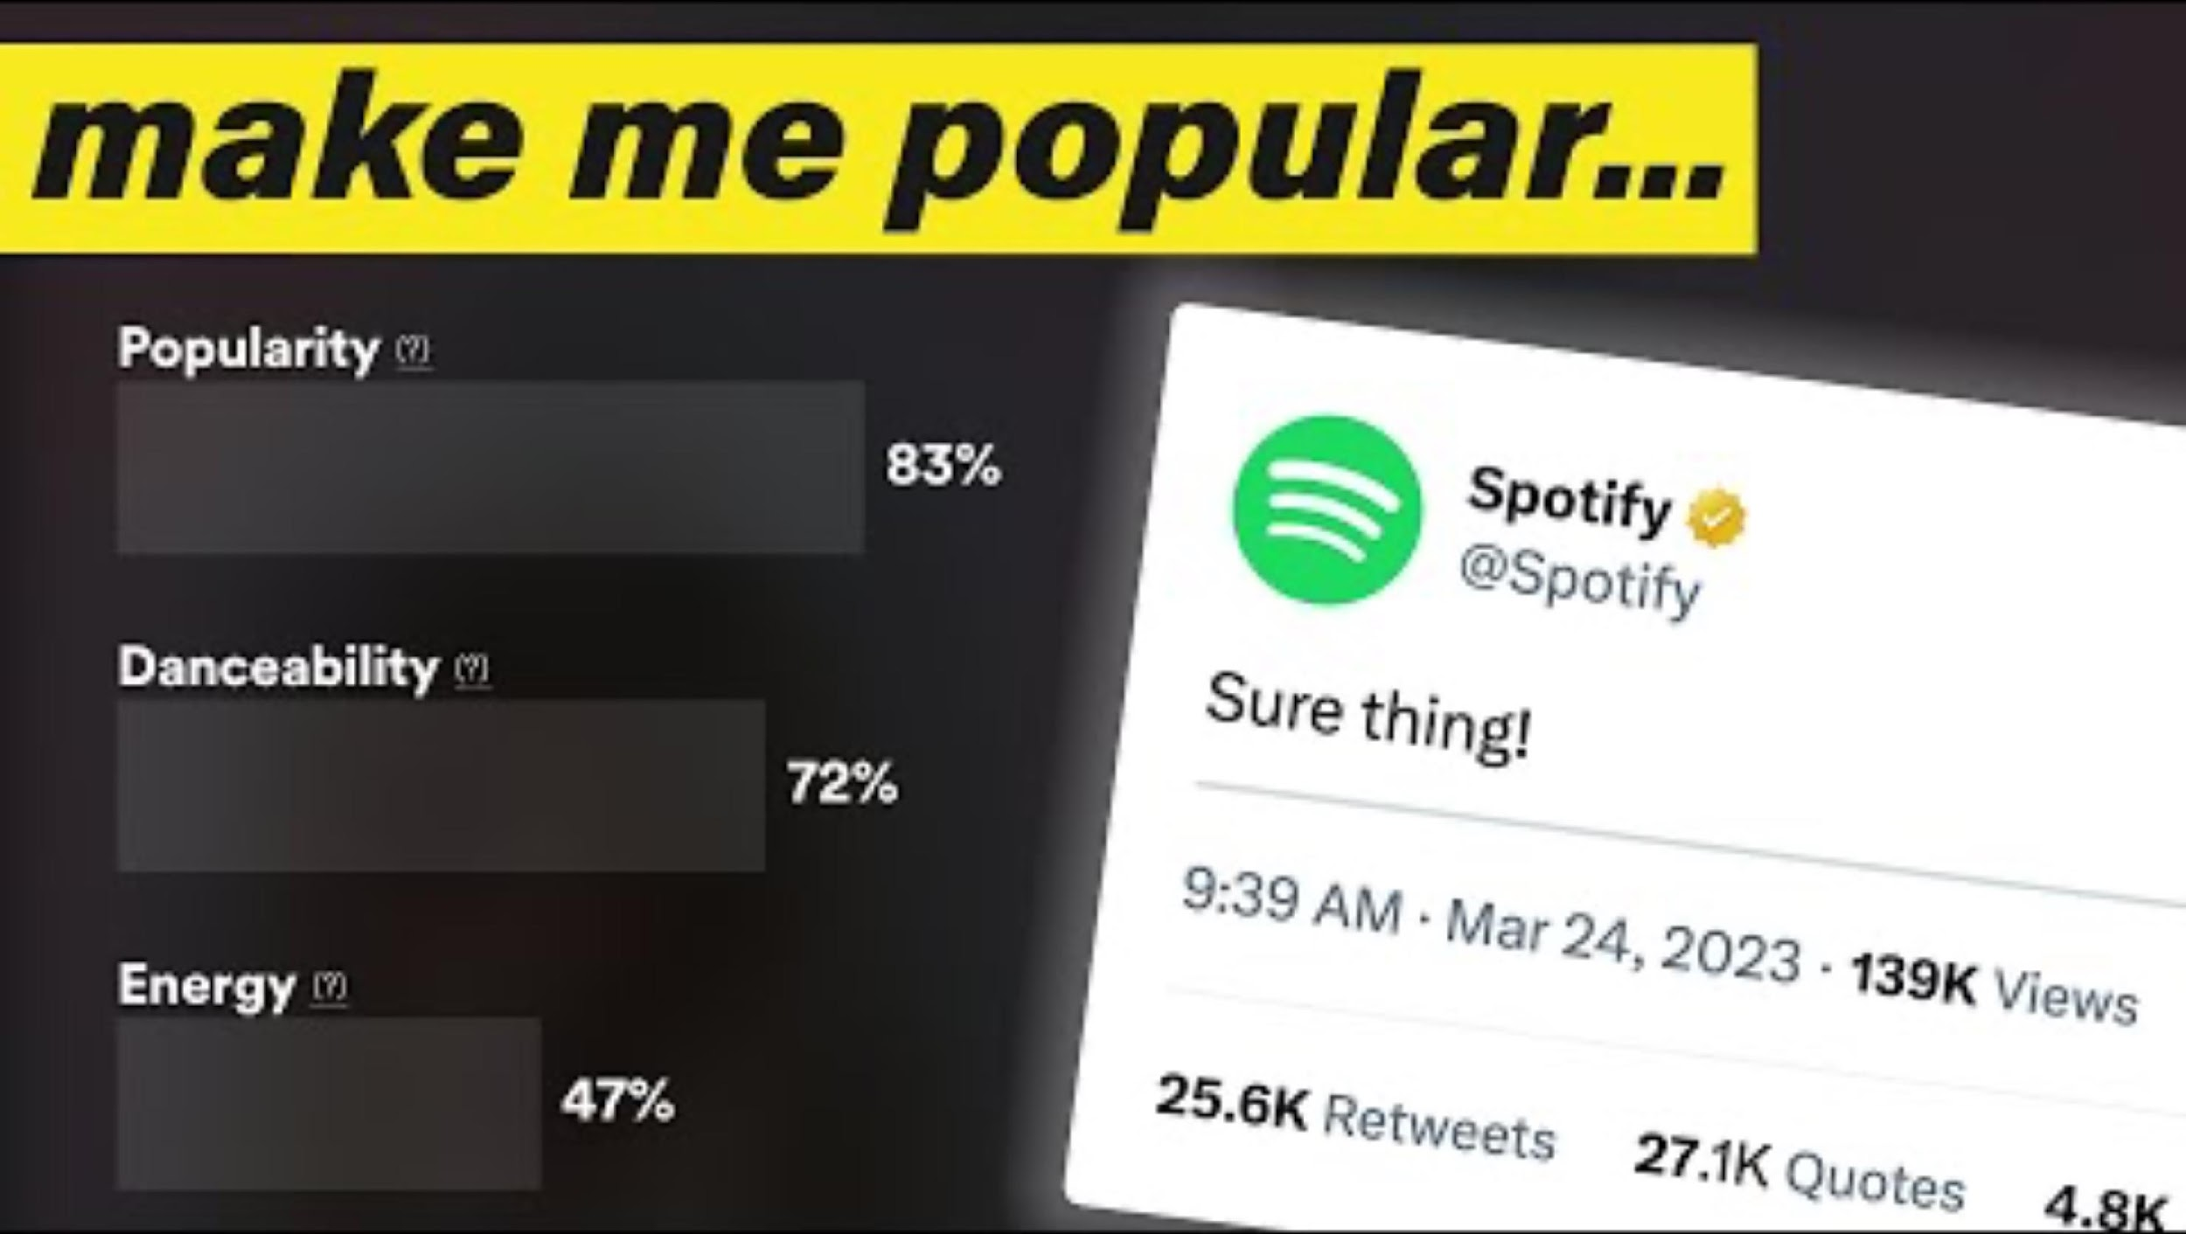
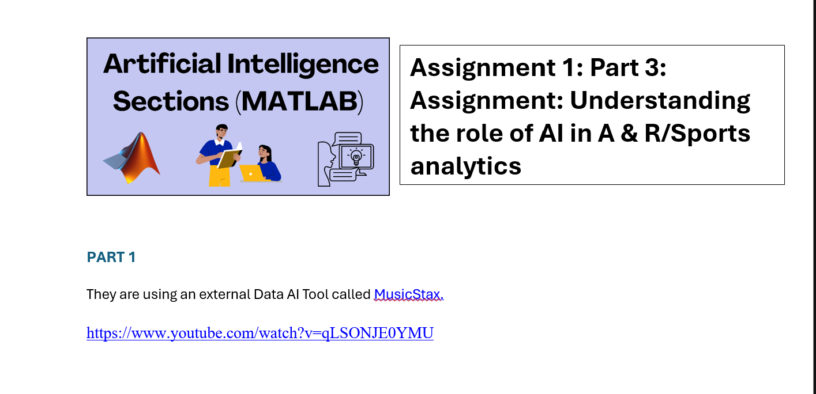
To Do:
Watch this video where a music artist shows how to track fan engagement for their music on Spotify. They are using an external Data AI Tool called MusicStax.
What is the popularity score- what specific data makes up the popularity score (1.59 mins in) What are the hidden metrics that goes into a popularity score? What other metrics (information) does the program provide to the artist?
Pick two musical artists in the same genre that you like. Look up their metrics for popularity, energy, danceability, positiveness, speechiness, liveness, instrumentationess. Compare the two. Who is the most popular and why do you think that is?

Slide 46
To Do:
What kind of data do you think they use for energy, danceability, positiveness, speechiness, liveness, instrumentationess?
Refine
In the video, at about 7:34 minutes in, the artist talks about the Discover Weekly Algorithm and how if you can get this to activate, then you can promote songs more.
What do you think an Algorithm is and what does it do here when it is triggered? What data is it using?

Slide 47

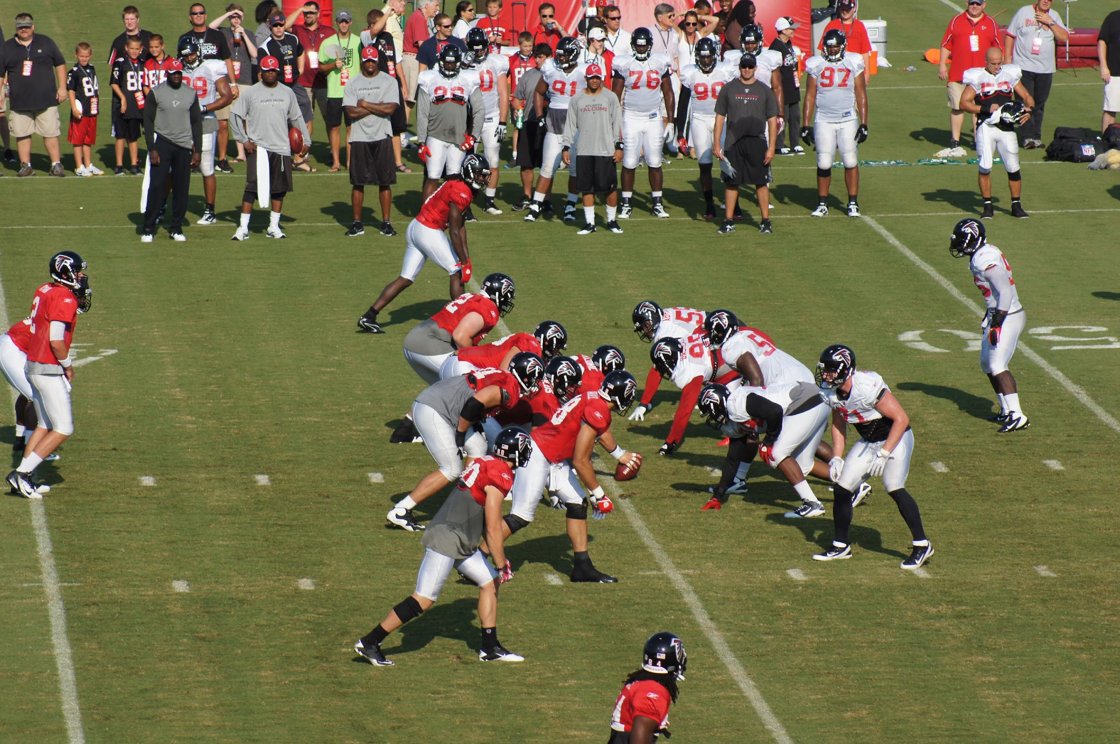
Understanding your job for this camp
As we work through the material for the camp, you will decide if you want to focus on Entertainment or Sports. Your job is to use and write an AI program that will analyze data and make some predictions

